Slide 1
ESHAN COLLEGE OF ENGG FARAH MATHURA NAME-DEEPAK KUMAR BRANCH-CIVIL ENGG SUB-HYDRAULICS & HYDRAULIC MACHINES

Slide 2
open channels (open channel flow)

Slide 3
Learning Objectives
1. Types of Channels
2. Types of Flows
3. Velocity Distribution
4. Discharge through Open Channels
5. Most Economical Sections

Slide 4
Learning Objectives
6. Specific Energy and Specific Energy Curves
7. Hydraulic Jump (RVF)
8. Gradually Varied Flow (GVF)

Slide 5
Types of Channels
Open channel flow is a flow which has a free surface and flows due to gravity.
Pipes not flowing full also fall into the category of open channel flow
In open channels, the flow is driven by the slope of the channel rather than the pressure

Slide 6
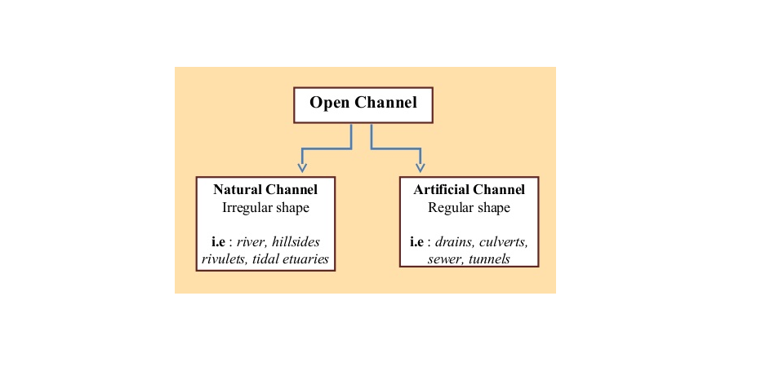
Types of Channels
Open channel flow is a flow which has a free surface and flows due to gravity.
Pipes not flowing full also fall into the category of open channel flow
In open channels, the flow is driven by the slope of the channel rather than the pressure

Slide 7
Types of Flows
1. Steady and Unsteady Flow
2. Uniform and Non-uniform Flow
3. Laminar and Turbulent Flow
4. Sub-critical, Critical and Super-critical Flow

Slide 8
1. Steady and Unsteady Flow
Steady flow happens if the conditions (flow rate, velocity, depth etc) do not change with time.
The flow is unsteady if the depth is changes with time

Slide 9
2. Uniform and Non-uniform Flow
1. Steady and Unsteady Flow
If for a given length of channel, the velocity of flow, depth of flow, slope of the channel and cross section remain constant, the flow is said to be Uniform
The flow is Non-uniform, if velocity, depth, slope and cross section is not constant
2. Uniform and Non-uniform Flow

Slide 10
2. Non-uniform Flow
Types of Non-uniform Flow
Gradually Varied Flow (GVF)
If the depth of the flow in a channel changes gradually over a length of the channel.
2. Rapidly Varied Flow (RVF)
If the depth of the flow in a channel changes abruptly over a small length of channel
1. Steady and Unsteady Flow
2. Uniform and Non-uniform Flow

Slide 11
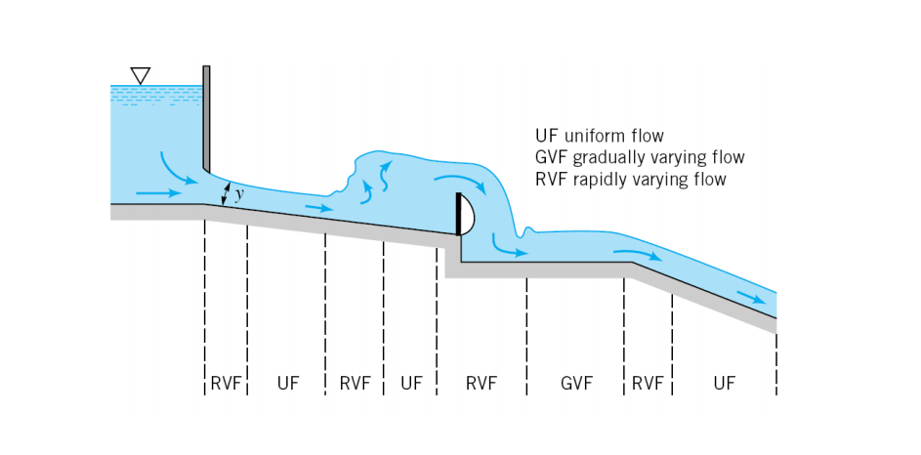
Types of Flows
1. Steady and Unsteady Flow
2. Uniform and Non-uniform Flow

